Slide 1
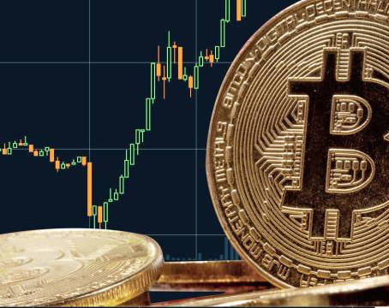
NFT Workshop
Bali Bitcoin Meetup Marvin F. L. Hansen
Notes:
Link to download slides: https://ufile.io/mnkta

Slide 2
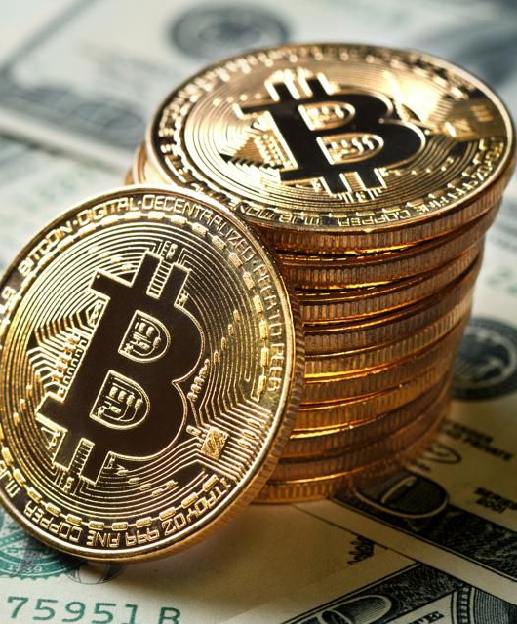
MISSION
Mission: “Help you to succeed financially!”
Goals:
Strengthen understanding of finances!
Practical application!
Smart investment!

Slide 3
Overview
Review Money:
Money system, Fiat & Commodity Currencies
Background:
Intro to Art Market
Intro to NFT
Practical session
Available marketplaces
How to make NFT's yourself
How to sell NFT's.

Slide 4
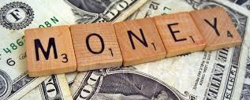

Slide 5
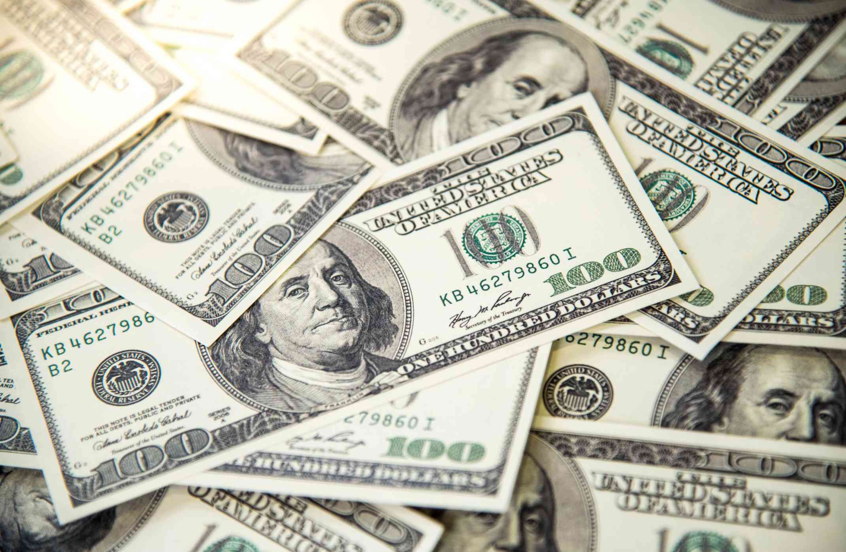
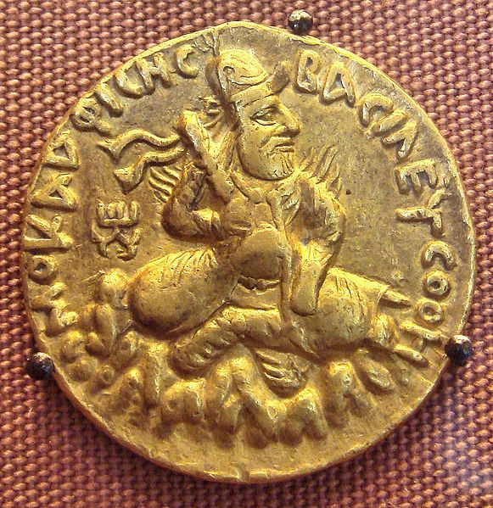
Two kinds of money
Commodity Money
Fiat Money
Money whose value comes from a commodity of which it is made!
Intrinsic value
Rare: hard to mine, or very difficult to acquire
Worth what people agree to pay!
Examples:
Gold coins
Rare spices
Silk, Jade etc.
Money created by Government through a legal degree
Zero intrinsic value
Gov. just prints it as needed
Worth what people believe its worth measured by the economic strength of the issuing country
Notes:
https://www.powercoin.it/en/cit-coin-invest-ag/5439-inca-sun-god-1-oz-silver-coin-5-palau-2021.html?gclid=EAIaIQobChMIkYexucK28AIVjhBgCh1UIAH-EAQYAyABEgIz1_D_BwE

Slide 6
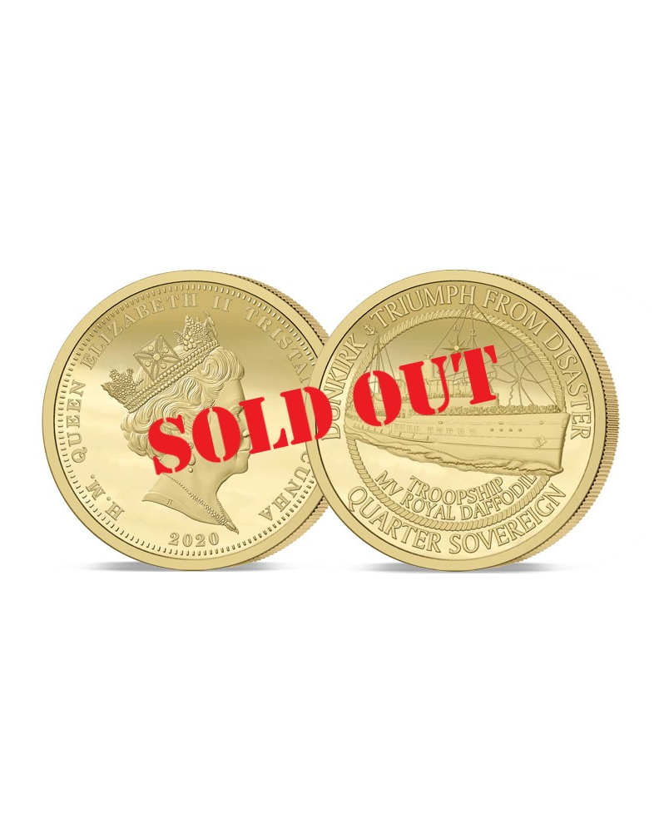
Commodity Money Problem
Don’t necessarily have the means to buy Gold…
Can’t mine more Gold than what’s in the Ground
Estimated $400 million Gold produced per year and that’s it.
Can’t get more than what’s available!
Need more, pay more, a lot more…
Gold more valuable and expensive in hard times

Slide 7
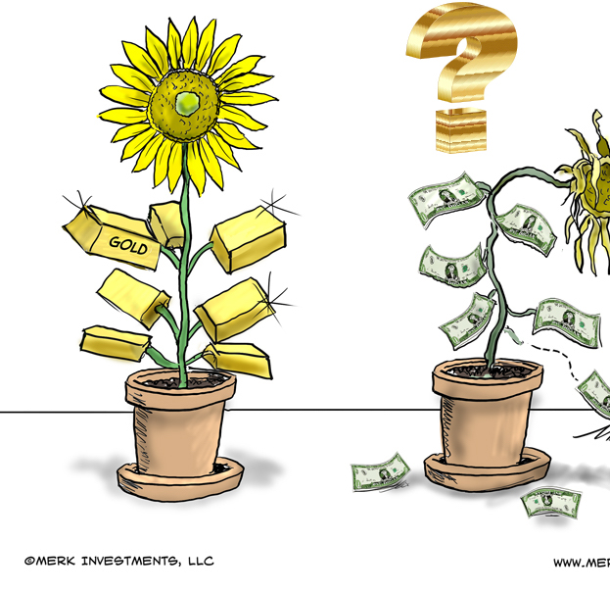
Fiat Money Problem
Printing too much money makes less valuable (inflation)
Not backed by anything else than public trust in the Government. Brexit & GBP....
Foreign Exchange Rates (Forex) swing widely during turmoil. Turkey & Lira…
Cash a lot less valuable than Gold!
Notes:
https://forum.vite.net/topic/2677/3-fiat-currencies-that-were-more-volatile-than-bitcoin-in-2019

Slide 8
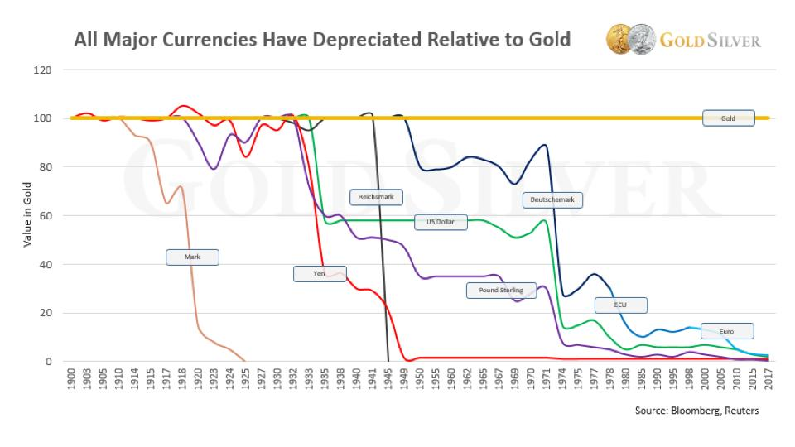
Notes:
https://www.gold-eagle.com/article/will-gold-replace-us-dollar-2020

Slide 9
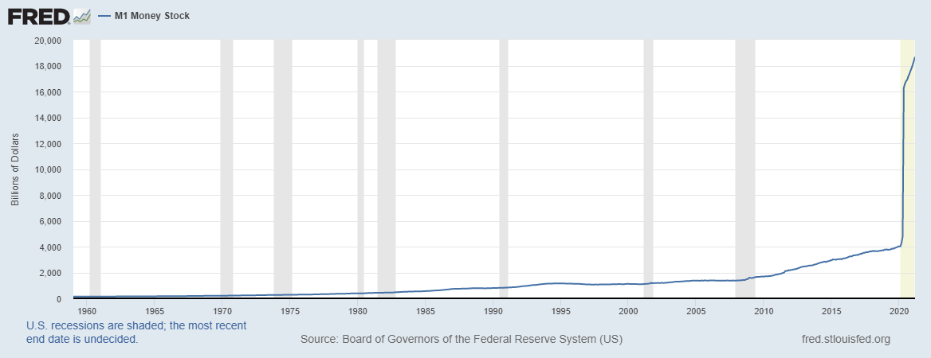
…. 12 TRILLION More $ in 2020!
Notes:
Let’s zoom in

Slide 10
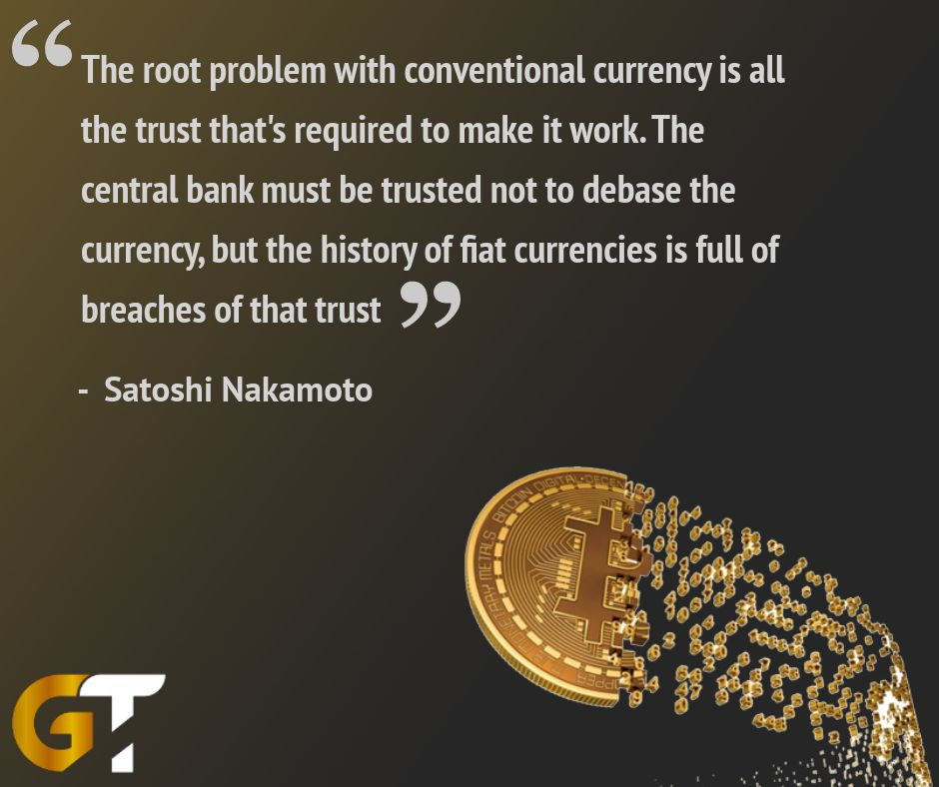

Notes:
https://twitter.com/goldtelegraph_/status/986715688717901824

Slide 11
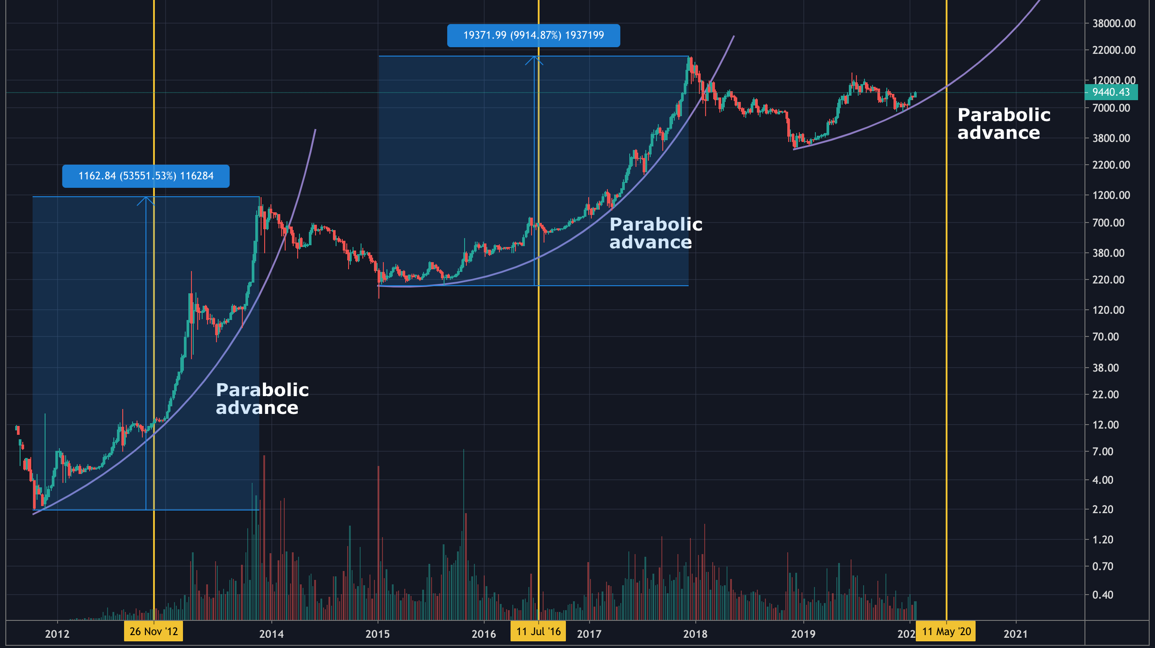

Slide 12

Summary
More money printed than ever in the history of mankind
Money loses more and more value
No saving possible because interest rates are about zero
The Fed, essentially, destroys the value of your hard-earned cash!
BTC acts more of a value store akin to GOLD but also increases in value due to decreasing supply

Slide 13
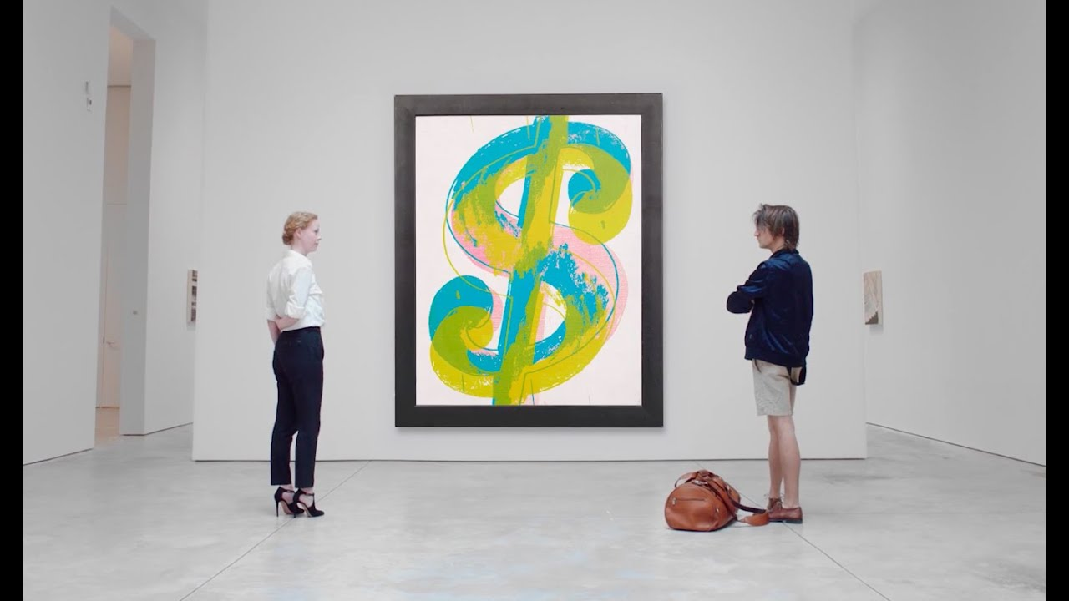
ART MARKET

Slide 14
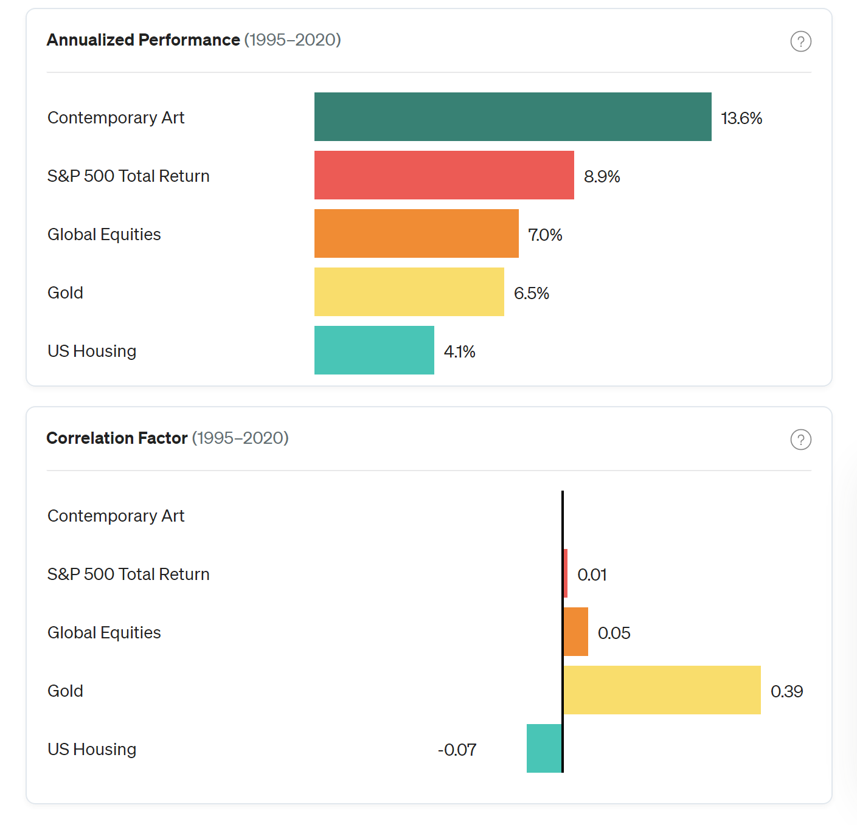
Art as an asset class

Slide 15
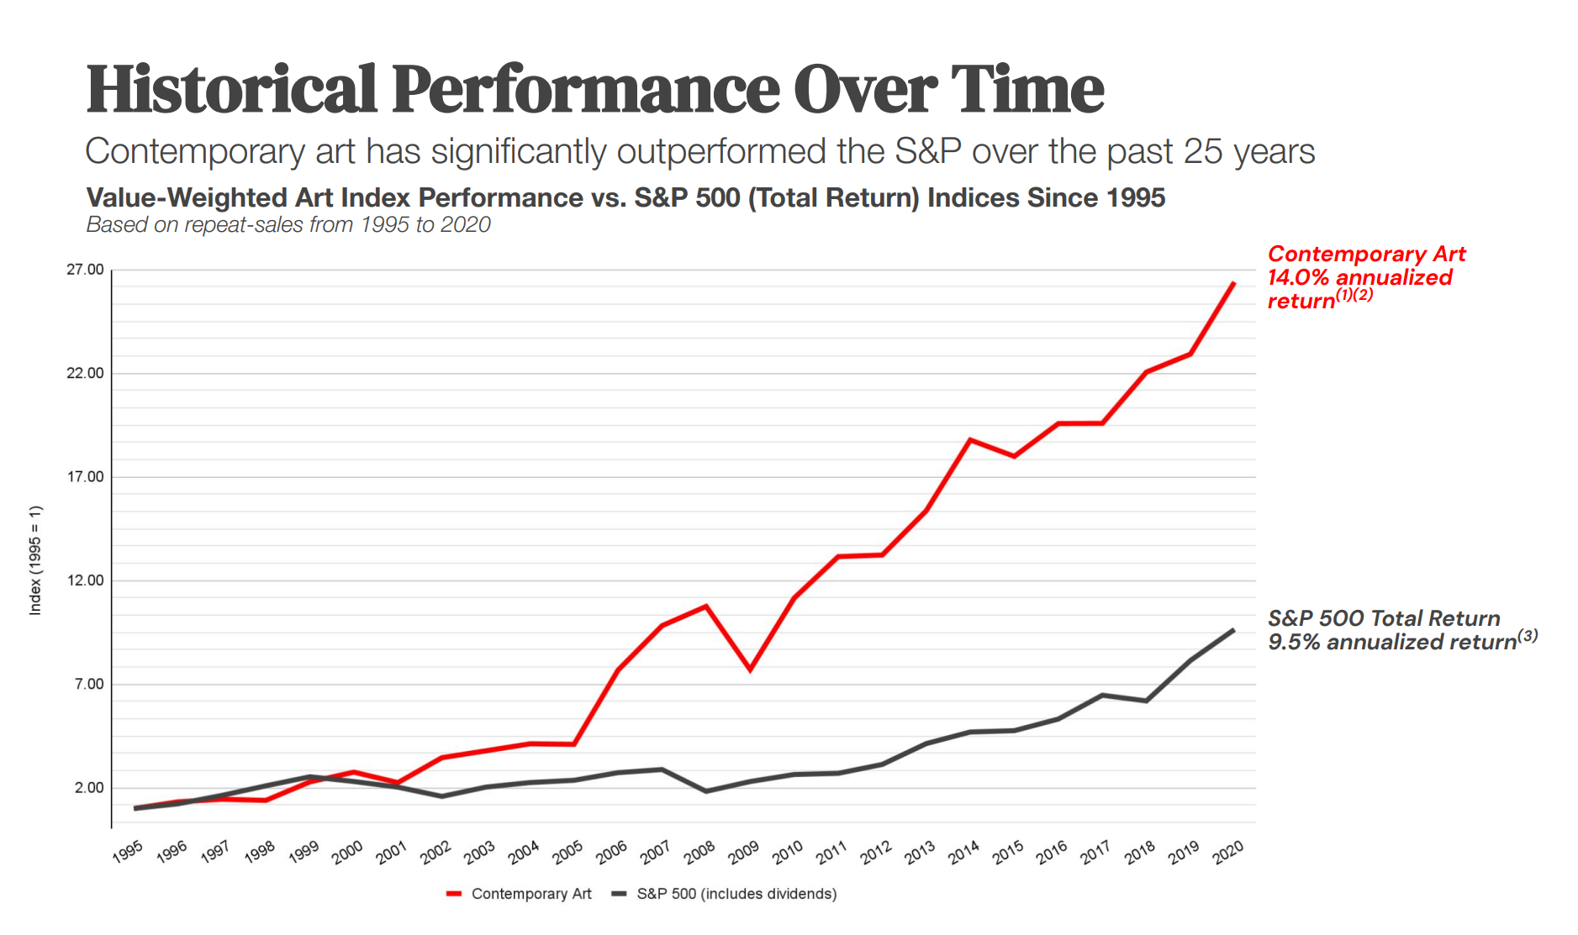
Art outperforms stocks
Notes:
https://assets.ctfassets.net/u7fuap5iqsvx/wO3wQ9IyWVeIoT57EWqmL/49ec38798a070c2f61ef6c7a7d785044/Masterworks_Overview_-_Understanding_Art_as_an_Investment.pdf

Slide 16
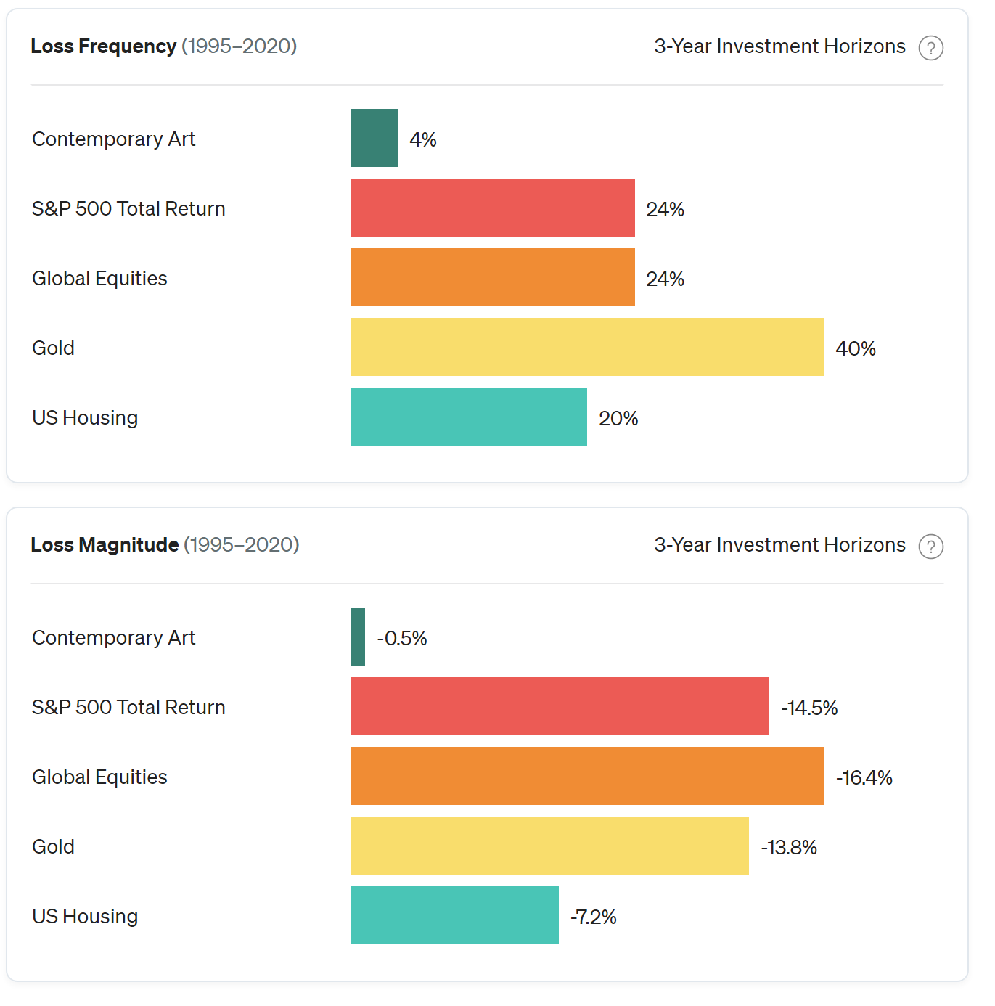
Low Loss Frequency & Magnitude
Notes:
Over the past 25 years, Contemporary Art has experienced losses approximately only 4% of the time measured over 3-year investment horizons.
Additionally, the global art market declined 26% during the financial crisis of 2008-2009, when the S&P 500 declined by 58%, according to Art Basel & UBS.
https://www.masterworks.io/research/post/47jJyoNpKXotaS68IuexvH

Slide 17
Entry Barriers
Buy side:
Usually requires multi million $ investments
Private marketplaces
Some auctions invite only
Sell side:
Selective galleries
Intermediaries
Art appraisal opaque, at best
Notes:
Over the past 25 years, Contemporary Art has experienced losses approximately only 4% of the time measured over 3-year investment horizons.
Additionally, the global art market declined 26% during the financial crisis of 2008-2009, when the S&P 500 declined by 58%, according to Art Basel & UBS.
https://www.masterworks.io/research/post/47jJyoNpKXotaS68IuexvH

Slide 18
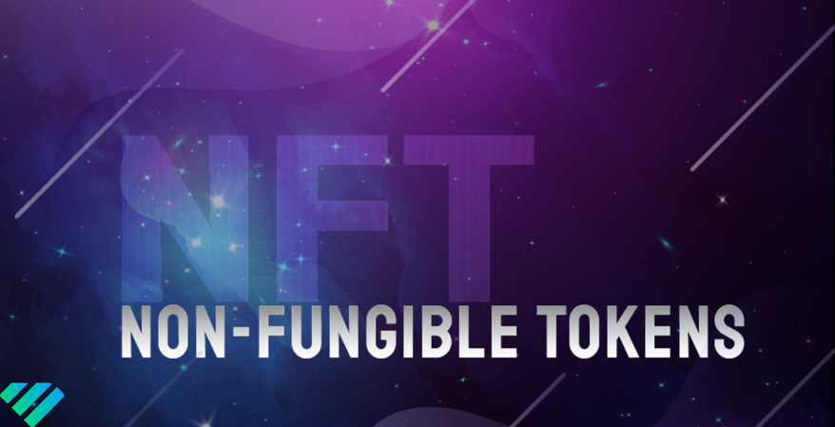

Slide 19
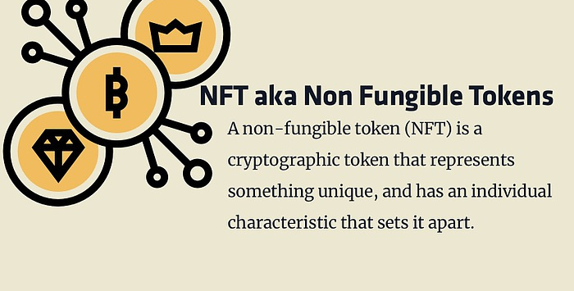

Slide 20
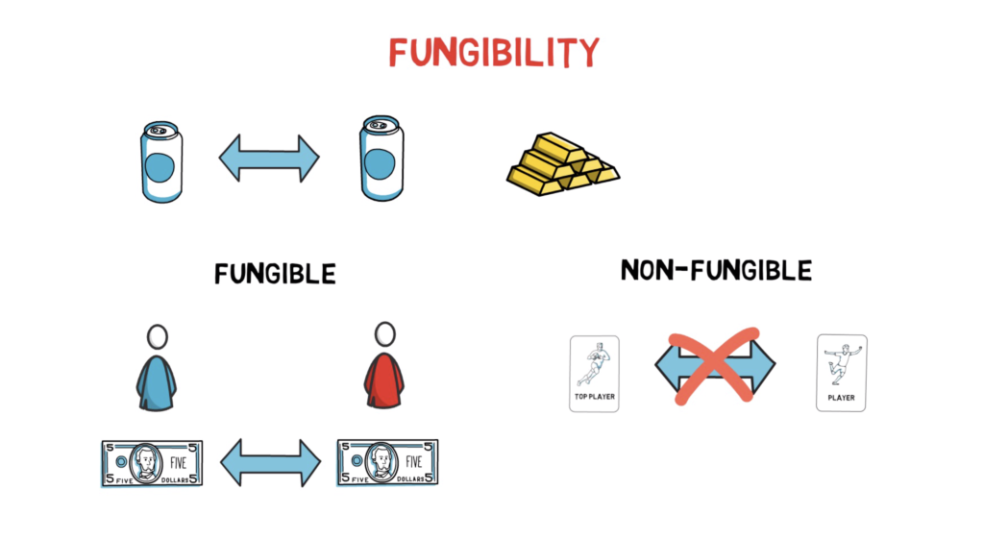

Slide 21
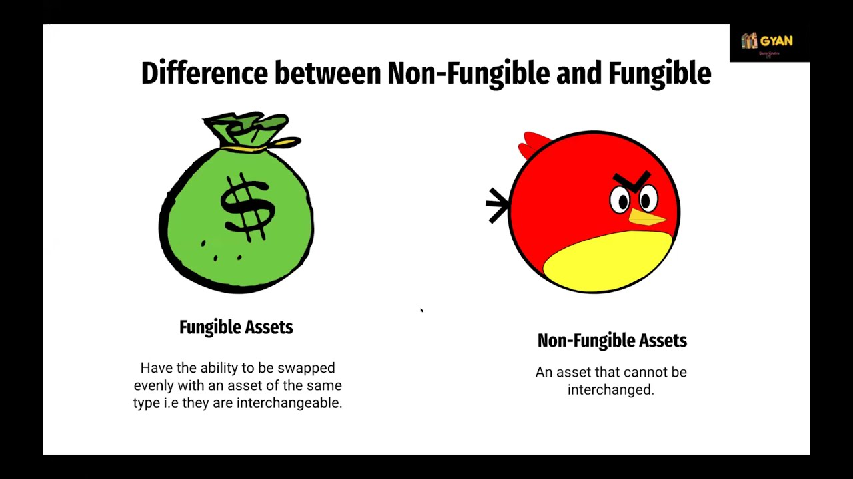

Slide 22
Crypto art
Buy side:
Investments ranges from anywhere between $1 and > 1 $ million
Public marketplaces
Open auctions
Sell side:
Open galleries
Direct sell
Prices determined by market
Transparent price history
Notes:
Over the past 25 years, Contemporary Art has experienced losses approximately only 4% of the time measured over 3-year investment horizons.
Additionally, the global art market declined 26% during the financial crisis of 2008-2009, when the S&P 500 declined by 58%, according to Art Basel & UBS.
https://www.masterworks.io/research/post/47jJyoNpKXotaS68IuexvH

Slide 23
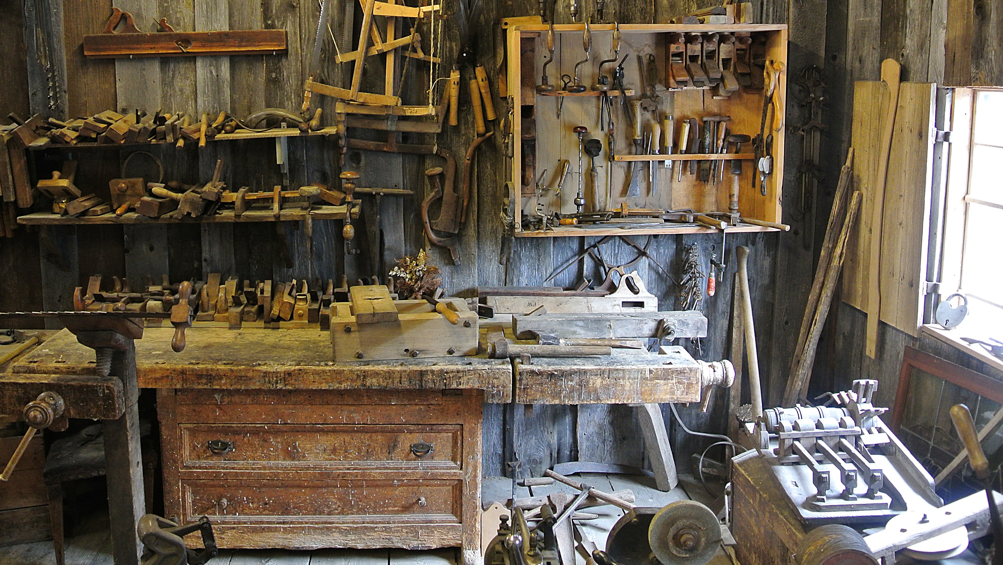
Workshop

Slide 24
Let’s create & issue an NFT
Pre-requirements
Crypto wallet with some ETH (MetaMask)
A digital artwork that is copyright free
OpenSea Account
That’s where you issue NFT’s
Requires only a onetime activation fee (in ETH)
Will be linked to your wallet

Slide 25
Let’s offer an NFT for sale
Once issued, you can sell your NFT
Fixed priced
Auction
Trading NFT’s – many marketplaces
Crypto.com
Binance.com (June)
Just google for more

Slide 26


Q & A

Slide 27
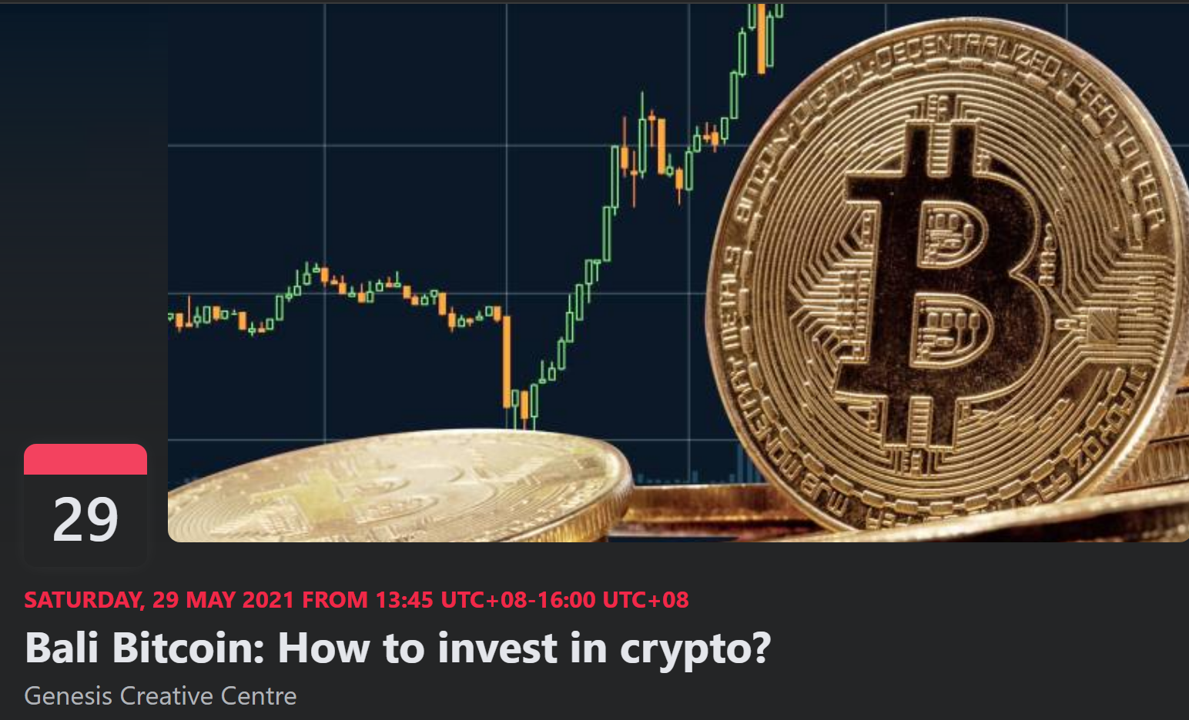
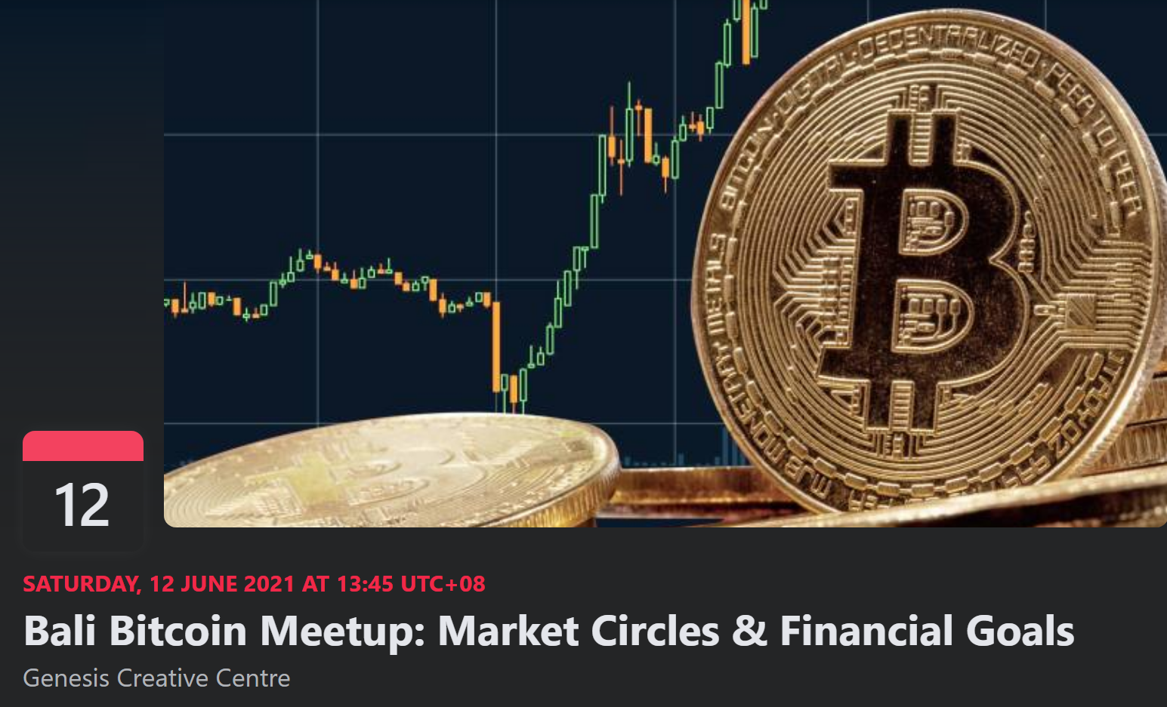
Next Events
May/29: How to invest in crypto?
June/12: Market circles & financial goals

Slide 28


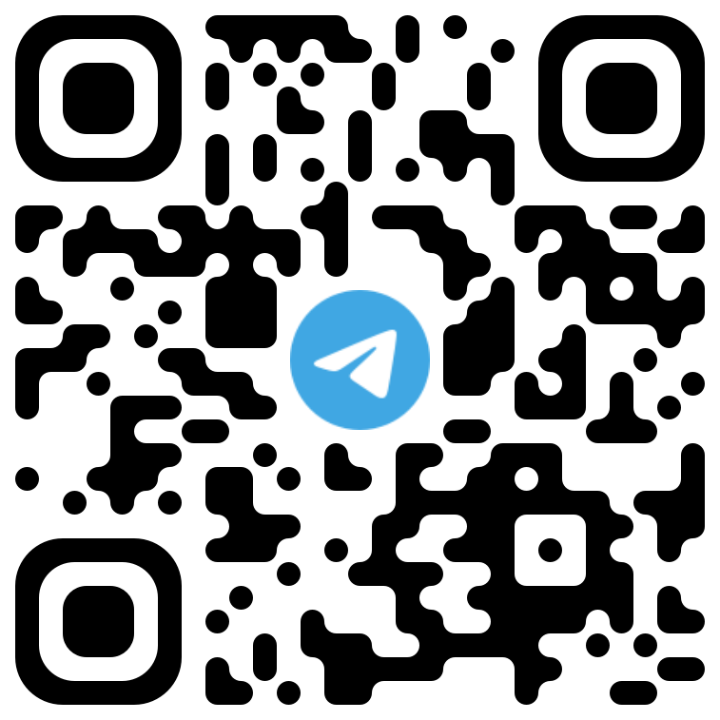
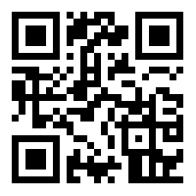
Community
https://t.me/joinchat/2T6yvFcokRQ3ZDQ0
/ Bali Bitcoin

Slide 29


